Slide 1


By Usman Basharat
ID number: S1300173
Unit 1

Slide 2

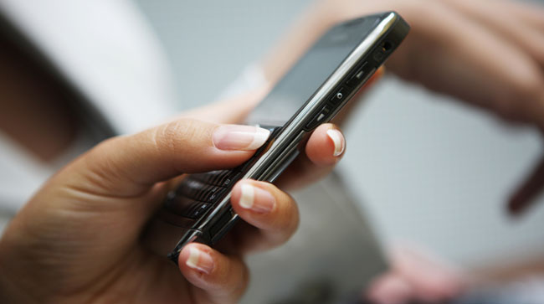
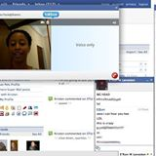
Definition of communication
Communication means exchanging of information usually through speaking to another individual, writing a letter to someone or typing messages to another individual on the internet.

Slide 3
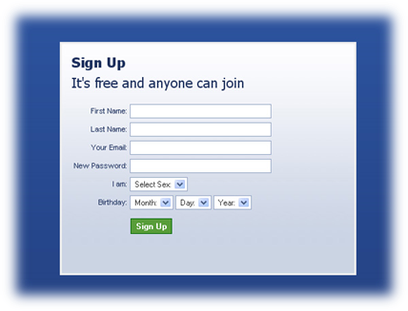
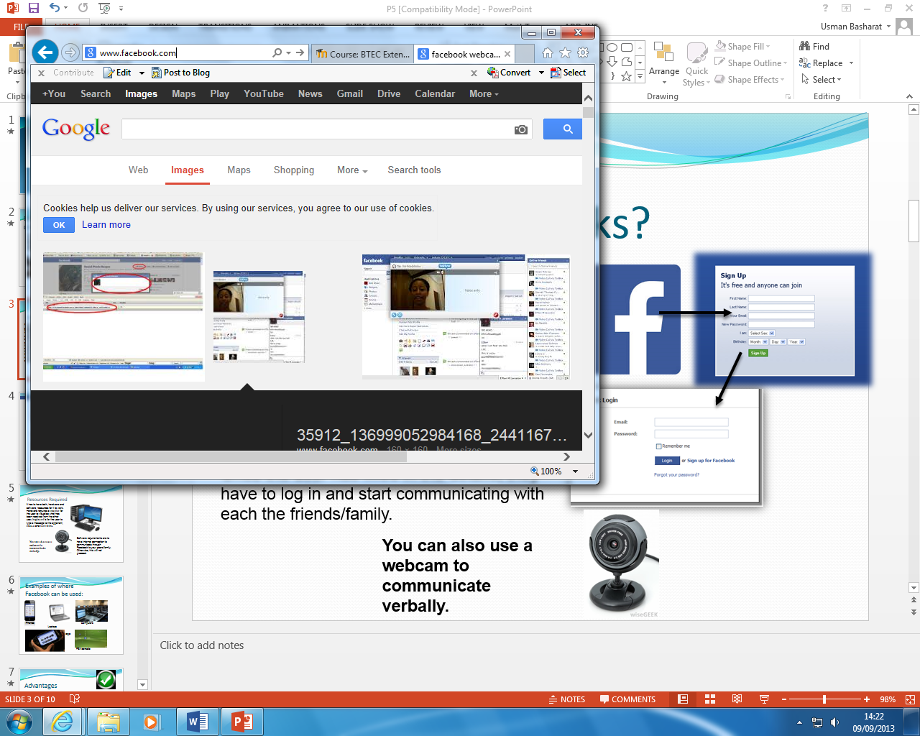
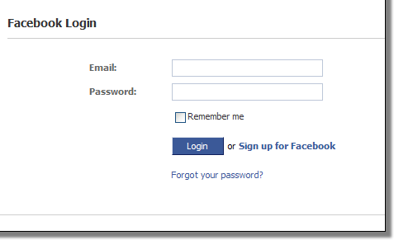
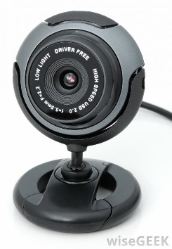
How Facebook works?
Facebook is a social networking site where communication can be used by verbal or SMS communication.
This can be found on the internet by searching, ‘Facebook’ up, mobile phones it can be downloaded by using Apple Store or Play Store, Laptops, computers and a lot more. Before communicating with others, registration is required for the user to fill in his/her details.
Once the user has filled in the details, they have to log in and start communicating with each the friends/family.
You can also use a webcam to communicate verbally.

Slide 4
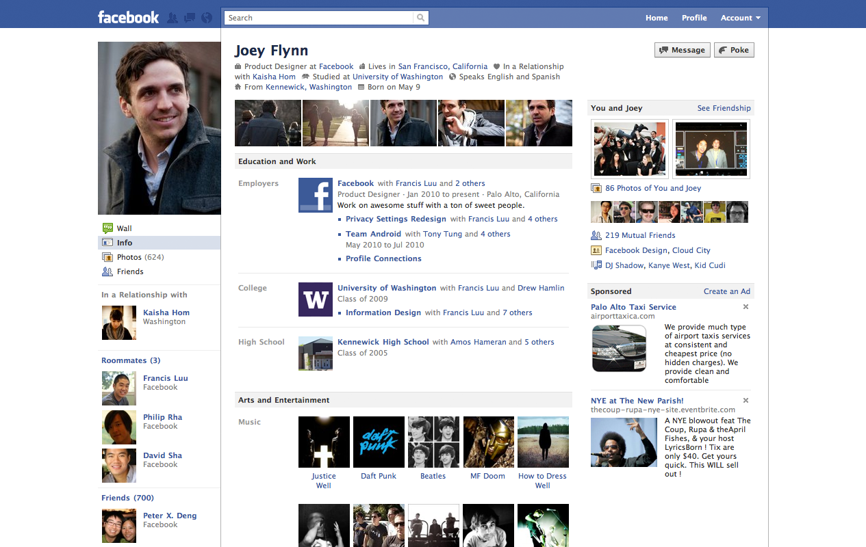

Slide 5

Resources Required
It has to have both, hardware and software, resources for it to work. Hardware requires a monitor for the user to visualise what has been received from the other user, keyboard is for the user to type a message to the opponent, mouse and hard drive.
It will need internet connection so a Ethernet cable will be required with a modem.
Software requirements are to have internet connection to communicate through Facebook to your peers/family. Otherwise, this will not proceed.
You can also use a webcam to communicate verbally.

Slide 6

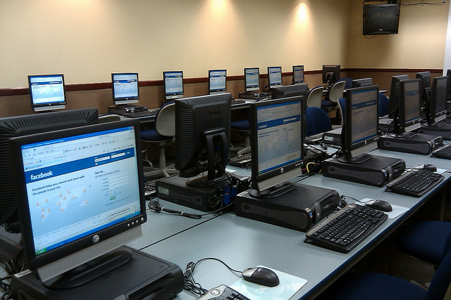
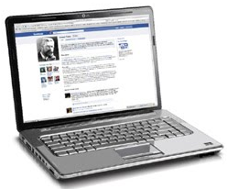
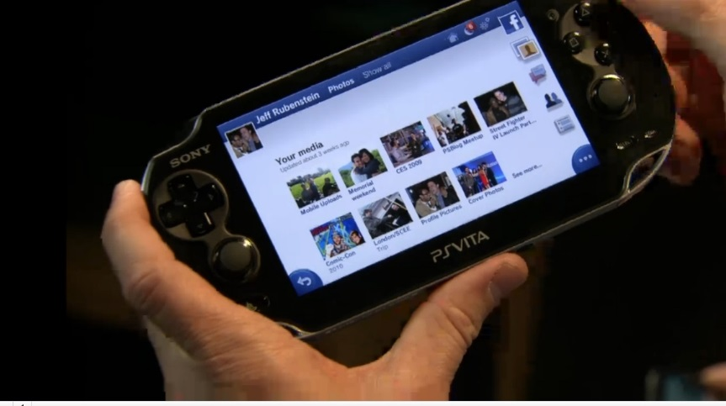
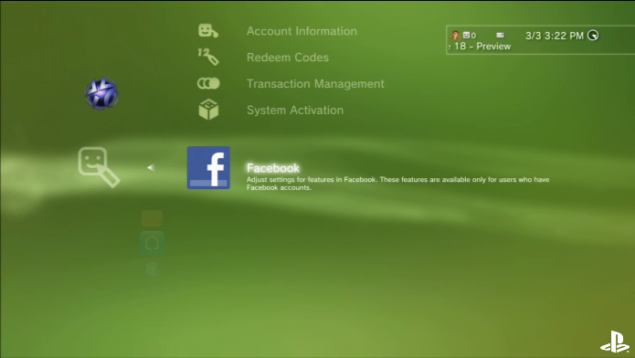
Examples of where Facebook can be used:
Phones
Computers
Laptops
PSP
PS4 console

Slide 7

Advantages
Anyone can use communication through Facebook
You can communicate to people that live far from the users house such as another country
Keep updated with peers
Fast and easy to communicate through internet, rather than sending letters which is slow
Express opinions and feelings on Facebook by making pages for campaigns. As this is world wide, people from around the world can see what is going on
It’s completely free, so you do not have to pay anything

Slide 8

Disadvantages
It requires internet for Facebook to work efficiently
It’s expensive, because Facebook is usually used on devices such as computers, laptops, mobile phones and these devices cost hugely for people who can’t pay for this
The internet connection may be slow so that the communication between peers is lost
The user may forget the username/password provided to them so they are unable to communicate with peers, friends or family
Difficulty using Facebook such as: elderly may find hard to use verbal communication or slow to type messages
You should be aware of inappropriate activities for young children

Slide 9
Summary
I think that Facebook is very useful, as its easier and quicker communication for people to keep in contact with each other. Also you can use it anywhere, whilst communicating with your friends wherever you are, but it requires top up for mobile phones to have access to the internet. It’s useful and its completely free. The user doesn’t have to pay anything for it.

Slide 10
References
http://www.google.co.uk/#q=communication+definition
http://www.streetdirectory.com/travel_guide/6023/online_business/internet_communication_methods.html
http://en.wikipedia.org/wiki/Communication

